Slide 1
A Continuum of Physics-Based Lithium-Ion Battery Models
Muhammad Saad
Graduate Research Assistant
Mechanical Engineering Department
Allen E. Paulson College of Engineering and Computing
Georgia Southern University

Slide 2
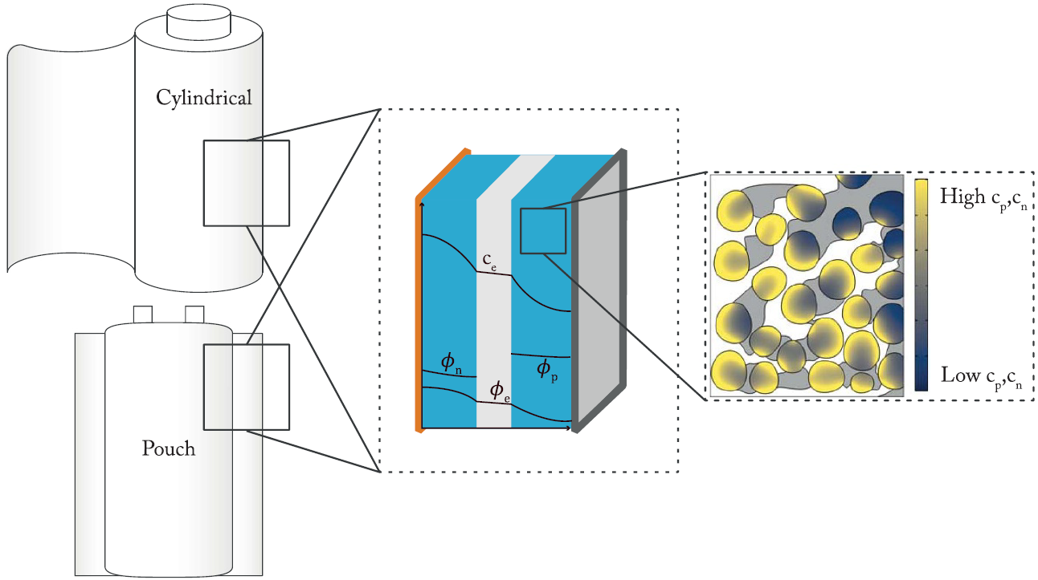
Why Model & The Continuum
Battery
Cell
Particles
Lithium-ion batteries are complex electrochemical systems. To understand, predict, and optimize their performance, we use mathematical models.
Instead of discrete models, there's a continuum of models ranging in complexity
Simpler, faster models can be systematically derived from more complex ones by making specific simplifying assumptions.
Sketch of the battery components at different scales.
Reference: Based on Brosa Planella et al., Prog. Energy 4 (2022) 042003

Slide 3
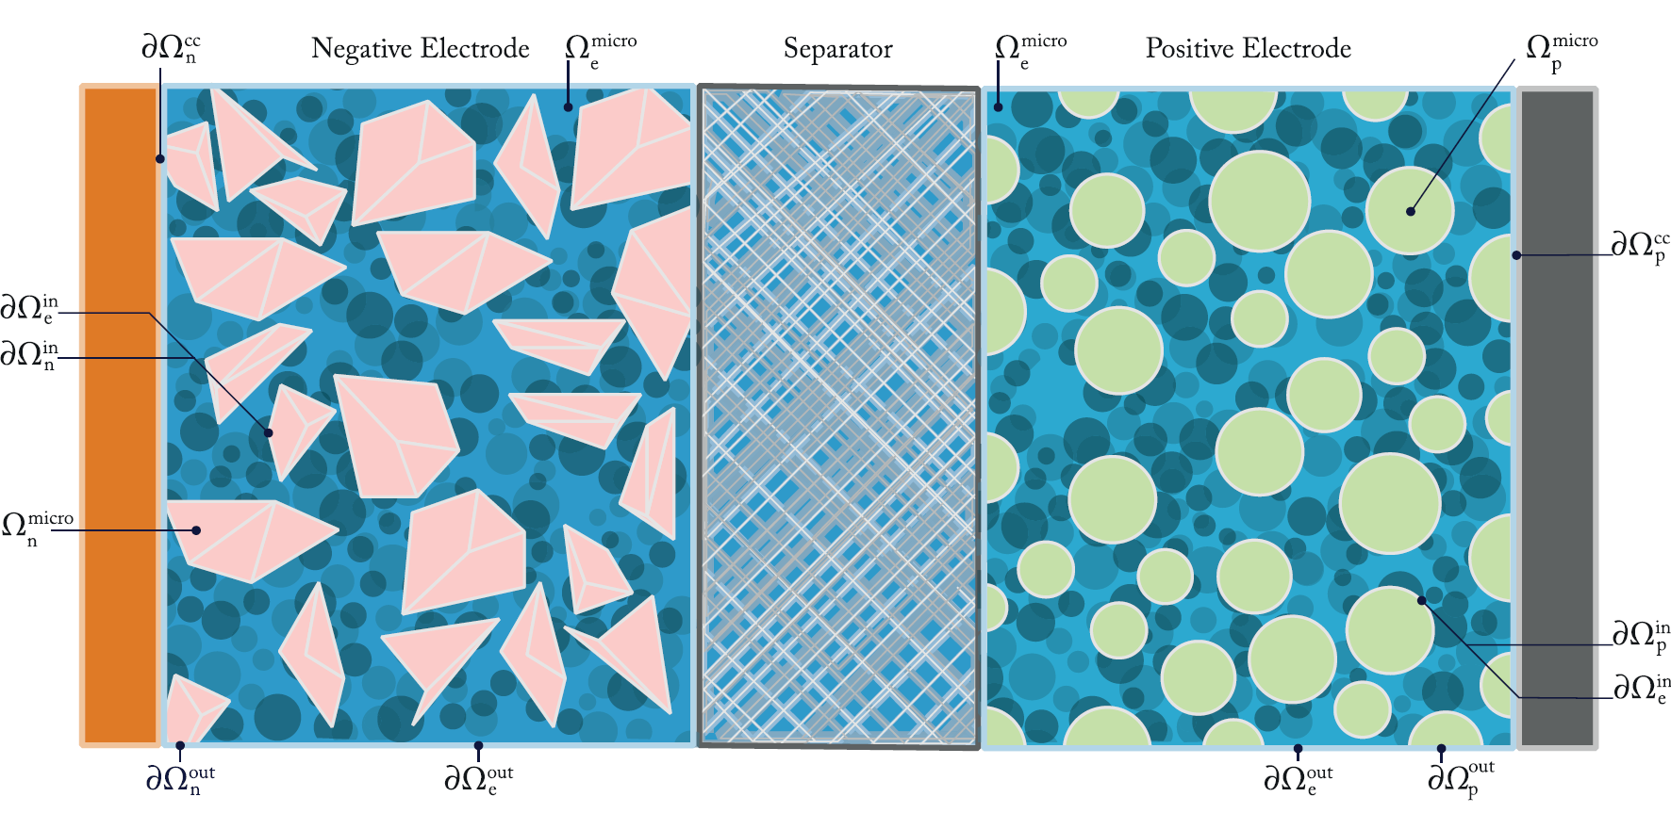






The Foundation: Microscale Model
Inside Particles (Solid)
$$∂c/∂t = ∇·(D∇c)$$
$$∇·i = 0,i = −σ∇φ$$
Inside Pores (Electrolyte)
$$∂cₑ/∂t = −∇·Nₑ$$
$$∇·iₑ = 0$$
At the Interface
${\tilde{J}}_{k}$= $j_{k0}sinh\left(\frac{F}{2RT}η_{k}\right)$
$j_{k0}$= F${\text{K}}_{k} \sqrt{\frac{c_{e}}{c_{e0}}\frac{c_{k}}{c_{k}^{max}}\left(1−\frac{c_{k}}{c_{k}^{max}}\right)}$
Captures microstructure effects
Requires detailed 3D geometry
Computationally expensive
Geometry Sketch of the microscale model
Reference: Based on Brosa Planella et al., Prog. Energy 4 (2022) 042003

Slide 4
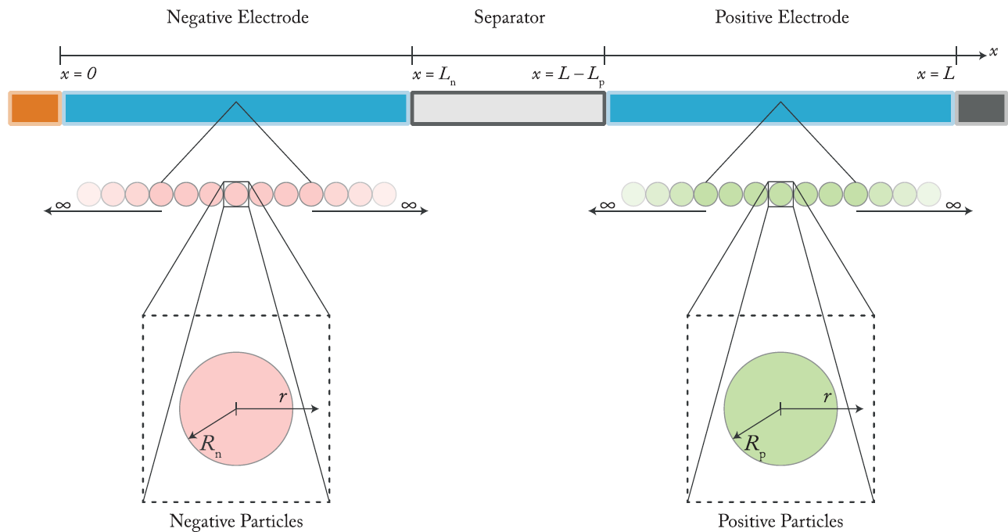
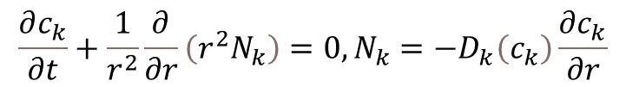
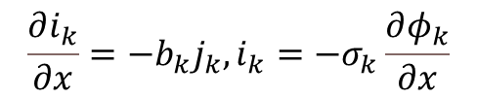
Reduction 1: Homogenised & DFN Model
Average over the microstructure treating the porous electrode as a continuum.
1D across the cell thickness (x-direction)
Assume particles are perfect spheres (1D radial, r-direction) Doyle-Fuller-Newman (DFN)
Inside each Particle (r):
$$\frac{∂c_{k}}{∂t}+\frac{1}{r^{2}}\frac{∂}{∂r}\left(r^{2}N_{k}\right)=0, N_{k}=−D_{k}\left(c_{k}\right)\frac{∂c_{k}}{∂r}$$
Across Electrode/Seperator (x):
$$\frac{∂i_{k}}{∂x}=−b_{k}j_{k}, i_{k}=−σ_{k}\frac{∂φ_{k}}{∂x}$$
$\frac{∂i_{e}}{∂x}=b\left(x\right)j\left(x\right), i_{e}=σ_{e}\left(c_{e}\right)$ $ℬ(x)\left(−\frac{∂φ_{e}}{∂x}+\frac{2}{F}\left(1−t^{+}\right)\frac{dμ_{e}}{ dc_{e}}\frac{∂c_{e}}{∂x}\right)$
Geometry sketch of the DFN model
Reference: Based on Brosa Planella et al., Prog. Energy 4 (2022) 042003

Slide 5
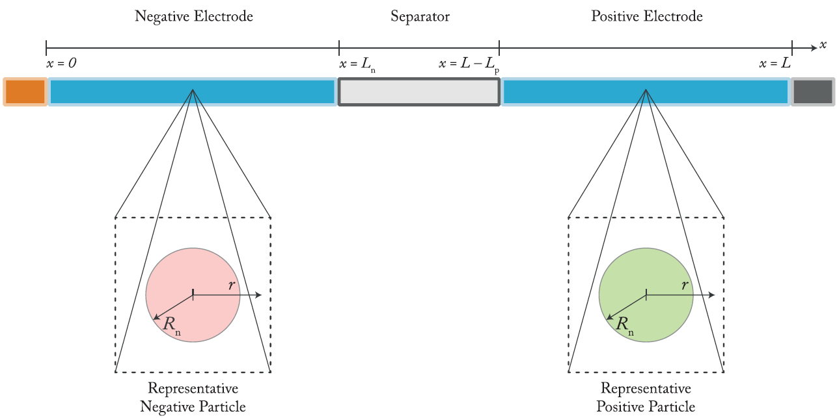
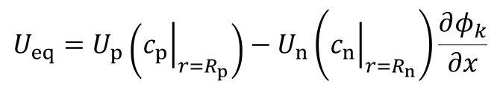



Reduction 2: Single Particle Models (SPMe & SPM)
Solve for one representative particle per electrode
$\frac{∂c_{k}}{∂t}=\frac{1}{r^{2}}\frac{∂}{∂r}\left(r^{2}D_{k}\left(c_{k}\right)\frac{∂c_{k}}{∂r}\right)$ $\text{in} 0<r<R_{k}$
$$V =U_{eq}−η_{r}$$
$$U_{eq}=U_{p}\left({\left.c_{p}\right|}_{r=R_{p}}\right)−U_{n}\left({\left.c_{n}\right|}_{r=R_{n}}\right)\frac{∂φ_{k}}{∂x}$$
$$η_{r}=\frac{2RT}{F}arcsinh\left(\frac{j_{n}\left(t\right)}{j_{n0}\left(t\right)}\right)−\frac{2RT}{F}arcsinh\left(\frac{j_{p}\left(t\right)}{j_{p0}\left(t\right)}\right)$$
Extremely fast, few parameters, captures basic charge/discharge behavior
Fails when electrolyte limitations or non-uniform currents are significant
Geometry sketch of the SPMe model
Reference: Based on Brosa Planella et al., Prog. Energy 4 (2022) 042003

Slide 6
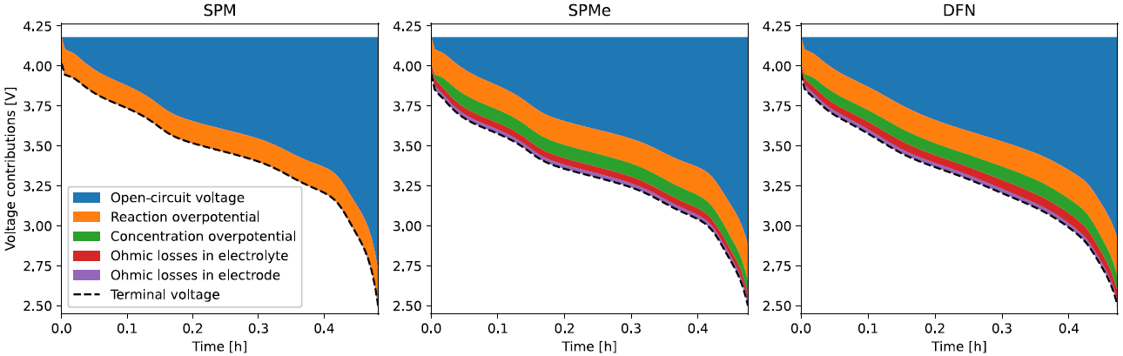
Selecting the Right Model
Comparison of the various contributions to the terminal voltage between the SPM, SPMe and DFN model.
Reference: Based on Brosa Planella et al., Prog. Energy 4 (2022) 042003

Slide 7
Conclusion
Physics-based battery models exist as a continuum, linked by systematic simplifying assumptions.
Understanding this hierarchy (Microscale -> DFN -> SPM) allows us to choose the appropriate model complexity for our specific application, balancing accuracy needs with computational constraints.
The systematic reduction framework provides a powerful tool for deriving consistent, simplified multi-physics battery models.
Reference: Based on Brosa Planella et al., Prog. Energy 4 (2022) 042003

Slide 8
Thank You!

